Slide 1
CSCI Group Project: Calendar App
Jeremy Gordon
Kyle Byassee

Slide 2
BACKGROUND
Our project:
A unique approach to a traditional calendar application.
Why we chose this project:
We wanted to expand our knowledge in C#, we opted to research and improve a wpf calendar object by providing additional freedom and features.

Slide 3
The How
Using a built-in calendar object, we modified the functionality and used some built in methods.
We use the decorator and observer design patterns.
Combining these technical and operational methods, we were able to meet our goals and vision for our application.

Slide 4
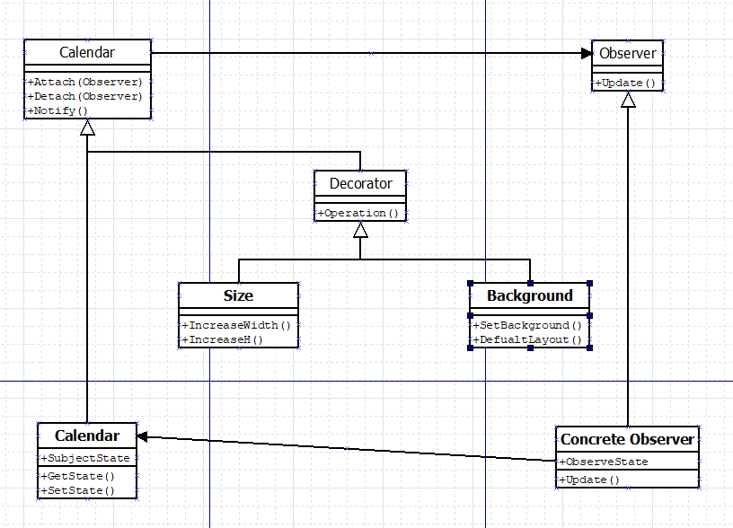
Class Diagram

Slide 5
DEMO
Show The Project
Add event
Remove event
Set Background
Demo Event occurring

Slide 6
The Future of Our Application.
Ultimately, we would like to create and implement new features into our application.
Specifically, we would like to implement importing and exporting from other calendar applications.

Slide 7
Contact Information EMAIL: jerrgord@ut.utm.edu kylhbyas@ut.utm.edu Repo: https://github.com/JeremyGord/CSCI-352-Group-Project.git

Slide 8
Questions?

